Slide 1

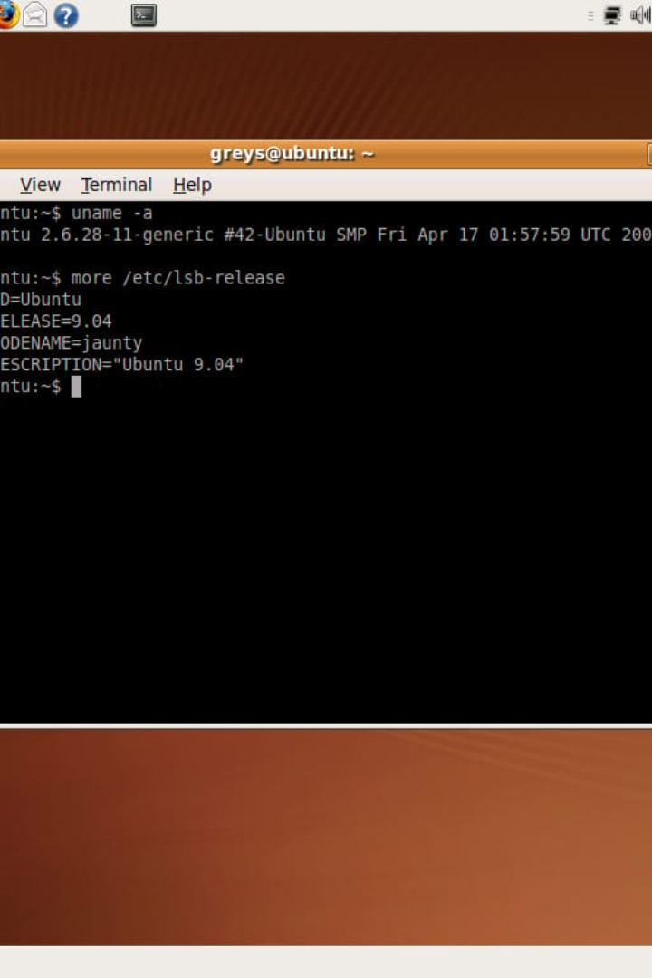
File Handling Utilities in Linux Programming
Learn about essential file handling utilities in Linux programming and how they can improve your workflow. This guide will cover the usage and options of key commands like mkdir, rmdir, cp, mv, rm, touch, cat, head, tail, and grep.

Slide 2

Mkdir
Create Directories
Options:
Use the mkdir command to create a directory with the specified directory_name.
-p: Create a directory and all its parent directories, if they do not exist.
-v: Verbose mode.
Syntax
--help: Displays the help information for the mkdir command.
mkdir | [options] directory_name
Example:
Create a directory named "documents":
mkdir documents

Slide 3
Rmdir
Remove Directories
Options:
Use the rmdir command to remove a directory with the specified directory_name.
-f: Force the removal of a directory, even if it is not empty.
-v: Verbose mode.
Syntax
--help: Displays the help information for the rmdir command.
rmdir | [options] directory_name
Example:
Remove the directory named "temp" if it is empty:
rmdir temp

Slide 4
Cp
Copy Files
Options:
Use the cp command to copy a file from the source_file to the destination_file.
-r: Copy directories recursively, meaning that all the files and directories in the directory will be copied.
Syntax
cp | [options] source_file destination_file
-p: Copy the file permissions and timestamps from the source file to the destination file.
Example:
Copy the file named "file1.txt" to the directory "Documents":
-v: Verbose mode.
--help: Displays the help information for the cp command.
cp file1.txt Documents/

Slide 5
Mv
Move Files
Options:
Use the mv command to move a file from the source_file to the destination_file.
-f: Force the move, even if the destination file already exists.
Syntax
-i: Interactive mode. Prompts before overwriting an existing file.
mv | [options] source_file destination_file
-v: Verbose mode.
Example:
--help: Displays the help information for the mv command.
Move the file named "file1.txt" to the directory "Documents":
mv file1.txt Documents/

Slide 6
ls
List Files
Options:
Use the ls command to list all the files in the current directory.
-a: Lists all files, including hidden files.
-l: Lists the detailed information
Syntax
r: Lists the files in reverse order.
ls [options] [file… | directory …]
-S: Lists the files by size.
-d: Lists only directories.
Example:
List all files in the current directory:
ls

Slide 7
Rm
Delete Files
Options:
Use the rm command to delete a file or directory.
-r: Delete directories recursively, meaning that all the files and directories in the directory will be deleted.
Syntax
rm | [options] file…
-f: Force the removal of a file, even if it is not writable.
Example:
-i: Interactive mode. Prompts before deleting a file.
Delete the file named "file1.txt":
-v: Verbose mode.
rm file1.txt
--help: Displays the help information for the rm command.

Slide 8
Touch
Change File Timestamps
Options:
Use the touch command to change the access time or modification time of a file.
-a: Change the access time of the file, without changing the modification time.
Syntax
-m: Change the modification time of the file, without changing the access time.
touch | [options] file…
Example:
-v: Verbose mode.
Change the modification time of the file named "file1.txt":
--help: Displays the help information for the touch command.
touch -m file1.txt

Slide 9
Cat
Read and Concatenate Files
Options:
Use the cat command to read and concatenate files, displaying their contents on the standard output.
-n: Number the lines in the output.
-b: Print a blank line after each new-line character in the input.
Syntax
-t: Print a tab character as a ^I.
cat | [options] file…
-v: Print a vertical bar (|) between adjacent lines.
Example:
--help: Displays the help information for the cat command.
Read the contents of the file named "file1.txt":
cat file1.txt

Slide 10
Head
Display the Beginning of a File
Options:
Use the head command to display the beginning lines of a file.
-n: Specify the number of lines to display.
Syntax
-c: Specify the number of characters to display.
head | [options] file…
-q: Quiet mode. Do not print any headers or messages.
Example:
Display the first 10 lines of the file named "file1.txt":
--help: Displays the help information for the head command.
head -n 10 file1.txt

Slide 11
Tail
Display the End of a File
Options:
Use the tail command to display the end lines of a file.
-n: Specify the number of lines to display.
Syntax
-f: Follow the file and display new lines as they are appended.
tail | [options] file…
-q: Quiet mode. Do not print any headers or messages.
Example:
Display the last 10 lines of the file named "file1.txt":
--help: Displays the help information for the tail command.
tail -n 10 file1.txt

Slide 12
Grep
Search for Patterns
Options:
Use the grep command to search for patterns in files.
-i: Ignore case distinctions in the pattern.
Syntax
-n: Number the lines that match the pattern.
grep | [options] pattern file…
-v: Print the lines that do not match the pattern.
Example:
Search for the word "hello" in the file named "file1.txt":
--help: Displays the help information for the grep comma
grep hello file1.txt

Slide 13

THANK YOU

